Slide 1
Housing and Macro Prudential Policy
David Miles
Imperial College London
July 8th 2016

Slide 2
Monetary Policy and Macro Prudential Policy – aims and tools
Monetary Policy is aimed at macro aggregates: the price level (or inflation rate); employment; output
Macro Prudential policy is aimed at maintaining financial stability
Monetary Policy tools are aimed at influencing the overall cost of lending and borrowing so as to influence overall economic activity
– by varying the short term nominal rate of interest or via changing the balance sheet of the central bank.

Slide 3
Monetary Policy and Macro Prudential Policy – aims and tools
Macro pru tools are varied
Some are very specific (almost like micro instruments) eg limits on high LTV lending or rules on what stresses mortgage lenders should use to asses potential borrowers ability to withstand shocks
Others are more widespread in their impact but still focused on specific sectors (eg capital ratio rules hit banks).

Slide 4
Monetary Policy and Macro Prudential Policy – aims and tools
You need (at least) two instruments because the policy needed to hit one target (eg consumer price inflation) and the stance to maintain financial stability might be very different. (Tinbergen)
Consider housing market and inflation picture today…CPI inflation is virtually zero; but in UK house price inflation is not.
Macro-prudential policy has been used several times just recently, mainly in the housing market.
But how do we work out whether rises in house prices are sustainable or not and whether they create financial stability risks?
Are rising house prices to incomes always a warning sign?

Slide 8
No growth in average real house prices from 1870-1945; tripling in the next 70 years – source “Global House Prices 1870-2012”, Knoll, Schularick and Stiga, 2014.

Slide 9
Land prices follow similar pattern as house prices source “Global House Prices 1870-2012”, Knoll, Schularick and Stiga, 2014.

Slide 10
But construction costs do not rise as much as land prices or real house prices source “Global House Prices 180-2012”, Knoll, Schularick and Stiga, 2014.

Slide 11
Looking to the very long term…
Suppose population and labour productivity grow at a steady rate in an economy. Can we expect the price of houses to stabilise relative to incomes?
When might the house price to income ratio be falling for long periods ..when rising?
What implications does this have for the return on capital?
Can we have an ever rising house price to income ratio?
Does that mean an ever declining owner occupation rate?
Should monetary and macro-prudential policy try to offset rising prices?
The answer depends on four – largely unrelated – factors:
Notes:
11

Slide 12
Looking to the very long
Four factors:
1. technology of producing houses – how are land and structures mixed.
2. preference for housing versus other goods and preferences for different mixes of land and structure in housing
3. the nature of bequests and how wealth is transferred from the old to middle aged and on to the relatively young.
4. The available mortgage loan to value ratio.
We focus on the first two…where it turns out that very different paths for the economy can emerge with even small changes in a couple of key parameters.
Notes:
12

Slide 13
Looking to the very long
Under plausible sets of parameters in a simple long run growth model we find house prices can rise forever relative to the price of other goods and also rise continually relative to incomes.
The key parameter is the substitutability of land and structures in the production of housing services.
This is a parameter that reflects technology and preferences. It is one that Muth investigated in detail some 40 years ago.
Its interpretation is subtle and how it evolves is of great significance.
Notes:
13

Slide 14
A model of housing and the wider economy over time:

Slide 23
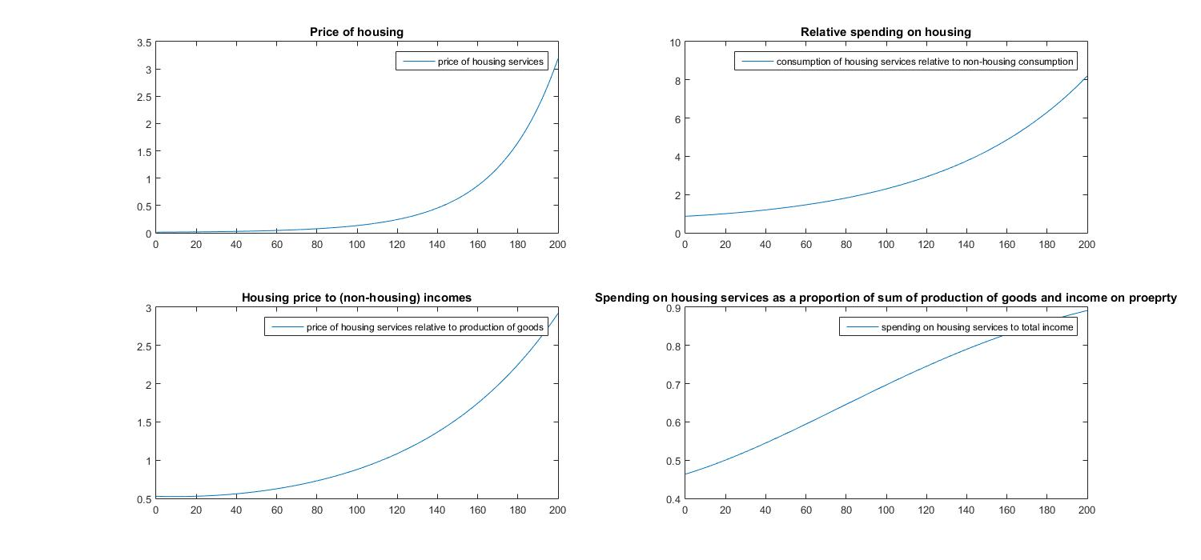
ε = 0.5 average annual house price growth 2.81%, growth in Y 1.90%

Slide 24
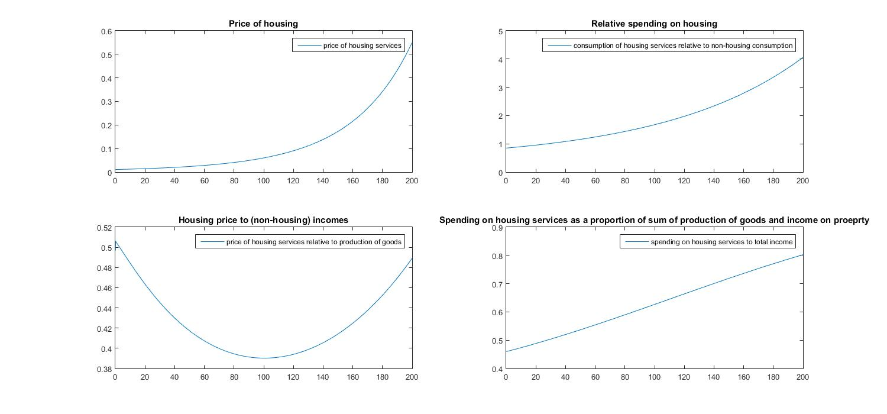
ε = 0.75 average annual house price growth 1.95%, growth in Y 1.90%

Slide 25
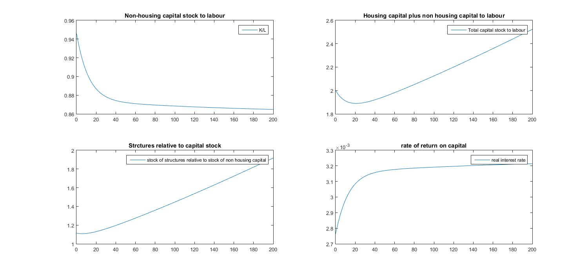
ε = 0.99

Slide 26
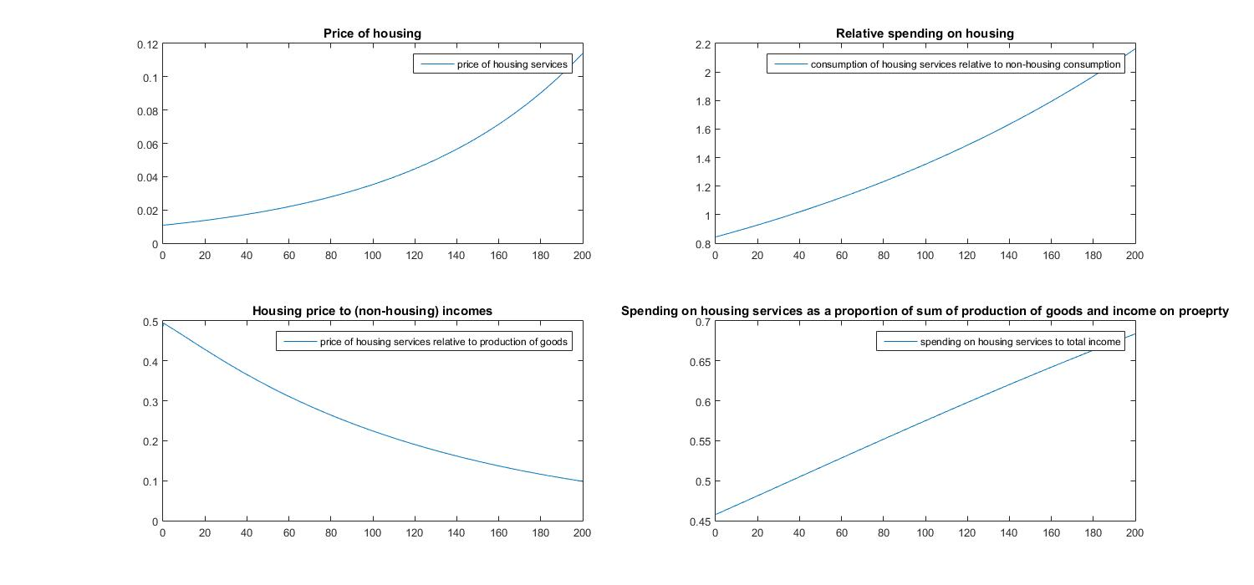
ε = 0.99 average annual house price growth 1.18%, growth in Y 1.90%

Slide 27
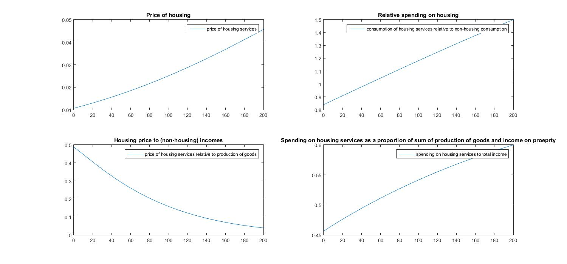
ε = 1.25 average annual house price growth 0.73%, growth in Y 1.90%

Slide 28
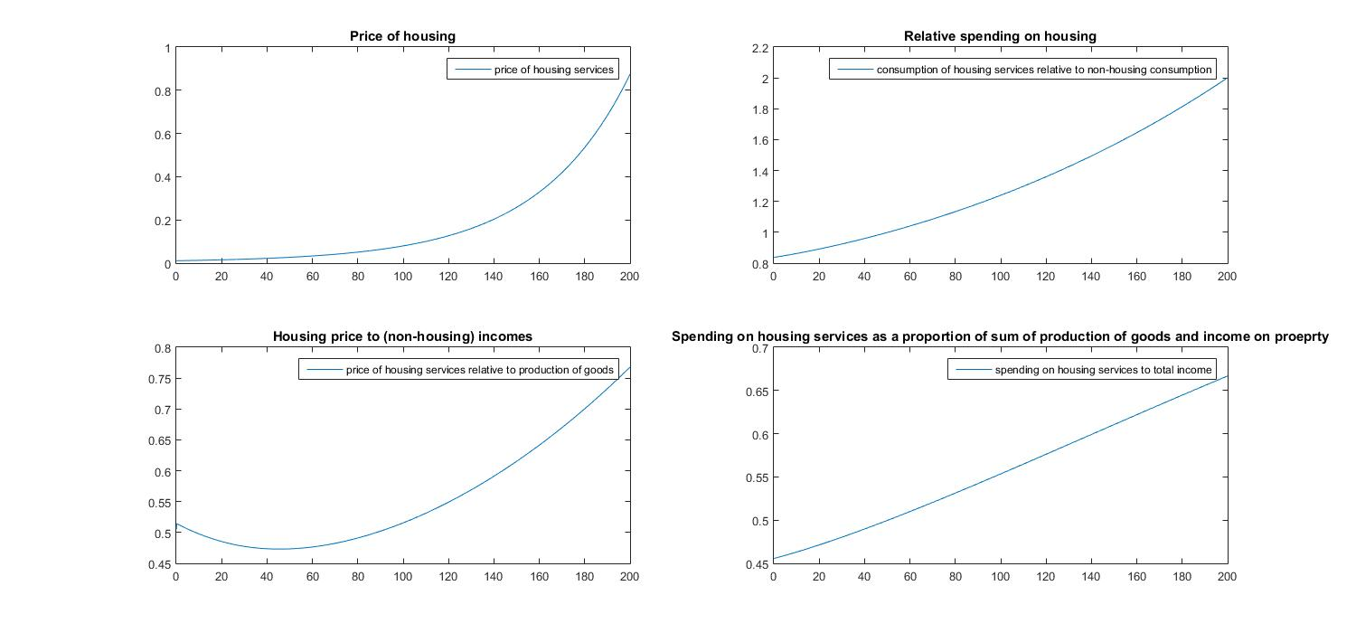
ε = 0.5, ρ=0.8

Slide 29
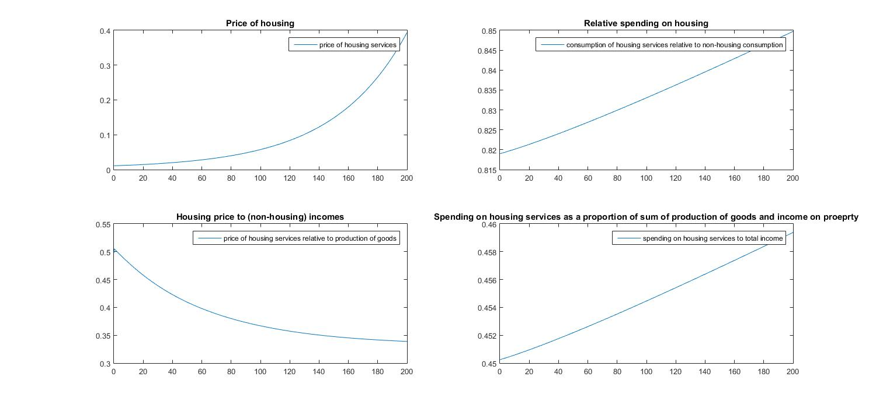
ε = 0.5, ρ=0.99

Slide 30
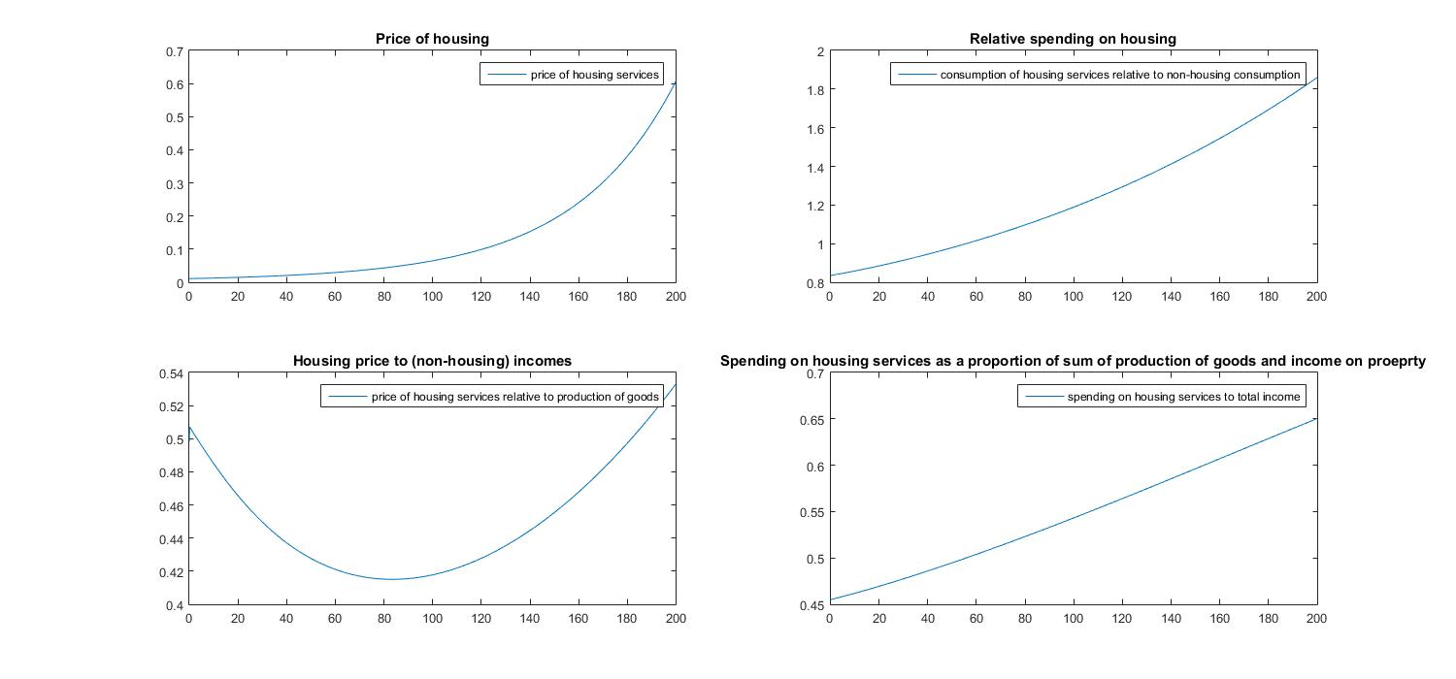
ε = 0.6, ρ=0.8

Slide 31
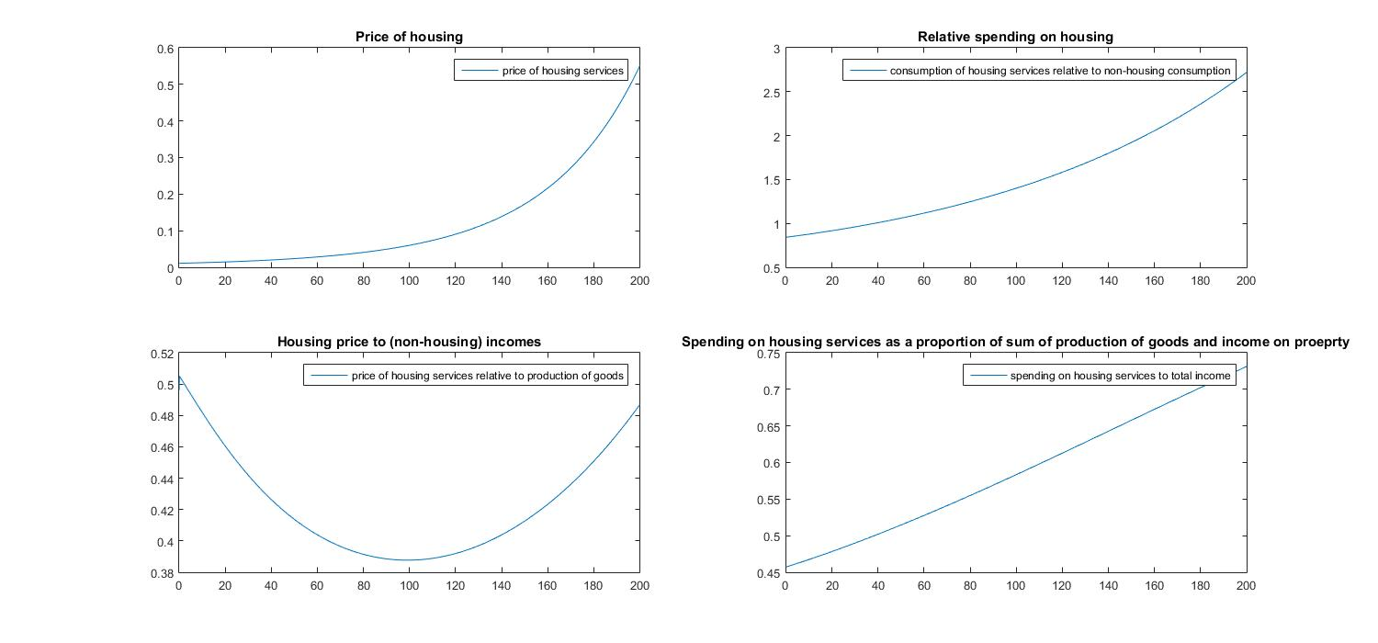
ε = 0.7, ρ=0.7

Slide 32
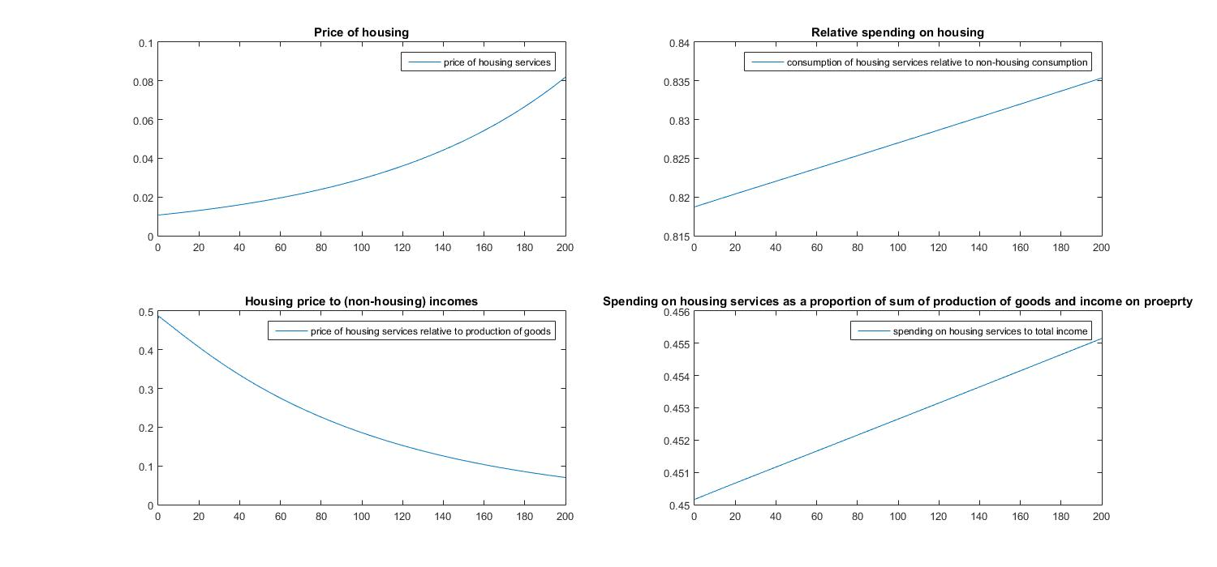
ε = 0.99, ρ=0.99

Slide 33
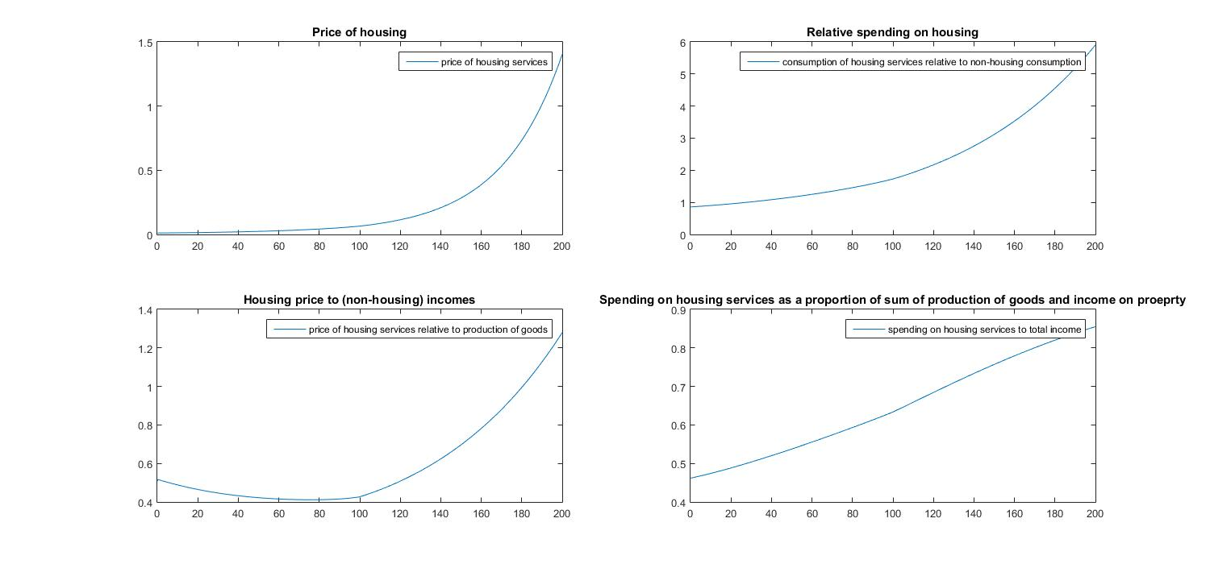
ε = 0.5, ρ=0.6 and growth in effective land area of 0.5% a year for first 100 years

Slide 34
Looking to the very long term…the key parameter
Muth – forty years ago – estimated that ε was about 0.5. But that was for US and it reflected 1970s and 1960s house building technology.
Maybe it reflected preferences too.
Both may change….
Super tall buildings with very small footprints are now feasible…and desired.
Notes:
34

Slide 35
Looking to the very long term…
From the NY Times, December 2015:
“As recently as two years ago, only five towers in NYC topped 1,000 feet. Now, there are that many “supertall” towers in the works on 57th Street alone, and roughly two dozen either under construction or on the drawing boards across Manhattan and in Brooklyn.
These slender cloud-busters would not have been built without the confluence of new technologies…. Superstrong concrete and new wind testing made possible buildings like 432 Park, which, at 93 feet wide, is 15 times as tall as it is wide.
In effect, developers now need only a lot the size of a brownstone or three to build a tower, rather than much of a block, as with the 1,250-foot Empire State Building, which, when it opened in 1931, was the tallest building in the world.”
Notes:
35

Slide 36
So what is ε ??
Q: By how much would you need to spend more on structure as the land used by a house is reduced to keep the house equally desirable?
With the production relation specified above (a CES function) the answer depends on the existing ratio of B to R and also on ε.
The next table shows the story…..
Notes:
36

Slide 37
percentage change in B to compensate for 1% fall in R, evaluated at various ratios of B/R and for various values of ε
 | ε | 1.2 | 1.1 | 1 | 0.8 | 0.7 | 0.6 | 0.5 | 0.4
B/R
1 |  | 1.01 | 1.01 | 1.01 | 1.01 | 1.01 | 1.02 | 1.02 | 1.03
2 |  | 0.90 | 0.95 | 1.01 | 1.21 | 1.37 | 1.62 | 2.06 | 2.97
3 |  | 0.84 | 0.91 | 1.01 | 1.34 | 1.63 | 2.13 | 3.13 | 5.63
4 |  | 0.80 | 0.89 | 1.01 | 1.44 | 1.85 | 2.60 | 4.21 | 9.02
5 |  | 0.77 | 0.87 | 1.01 | 1.52 | 2.04 | 3.02 | 5.32 | 13.21
6 |  | 0.75 | 0.86 | 1.01 | 1.59 | 2.20 | 3.42 | 6.45 | 18.34

Slide 38
Looking to the very long term…
I think intuition suggest that ε <1
That means that if land is fixed the elasticity of housing supply will go to zero.
Notes:
38

Slide 39
Looking to the very long term…issues for a richer model
Suppose house price to income ratio keeps on rising. But people can only borrow 90% of a house. Then it takes ever longer to buy.
Does the owner occupation ratio fall consistently?
What about bequests?
What does a society with 90% renting look like? This is Britain in 1914.
BUT: the houses would probably be owned much more equally – indirectly in savings vehicles owned quite widely.
There is no reason why a country with a low owner occupation rate need be one with very unequal ownership of wealth.
Notes:
39

Slide 40
Conclusions
Plausible parameter estimates plugged into a simple growth model can easily generate ever rising house prices – relative to other goods AND to incomes.
But there is great sensitivity to parameters that reflect both preferences (between different characteristics of houses) and technology.
The key technology factor is how one combines structures and land to create housing. That has changed …see the New York and London skylines. But can it make ε > 1?
Ownership structure cannot be assessed in our stylised infinite horizon, representative agents model. You have to introduce credit markets, finite lives and bequests.
Notes:
40

Slide 41
Conclusions
Housing over long term could become increasingly rented.
Houses could become like jets - too expensive for most people to own so almost exclusively rented…with people indirectly owning claims on houses (jets) via holding shares in property companies (airlines).
There is no reason to believe rising house prices to income ratios represent a risk to stability or are unsustainable
There should be no automatic policy response to a rise in house prices relative to incomes.
Notes:
41

